Slide 1
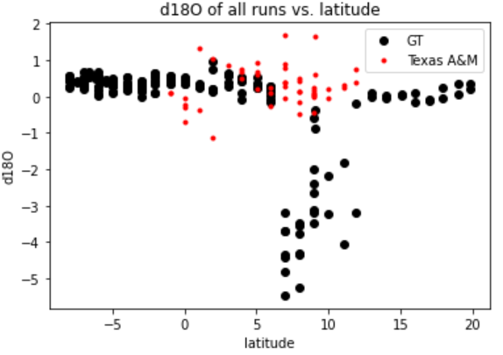
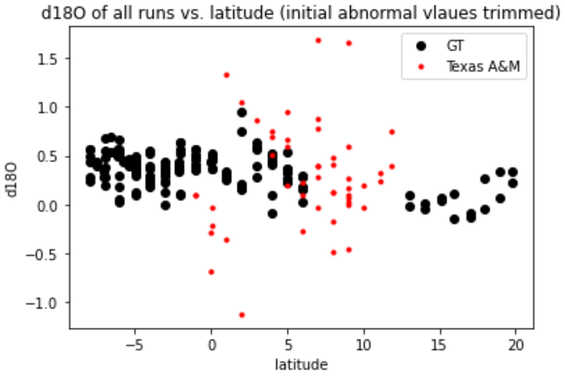
d18O vs. latitude, GT and Texas A&M runs
More spread in Texas A&M data

Slide 2
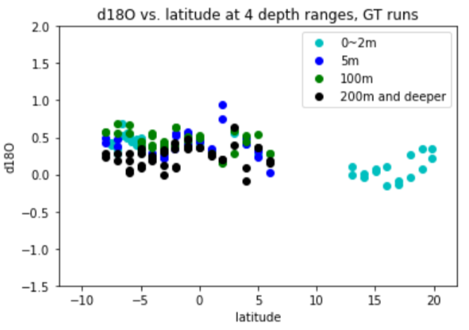
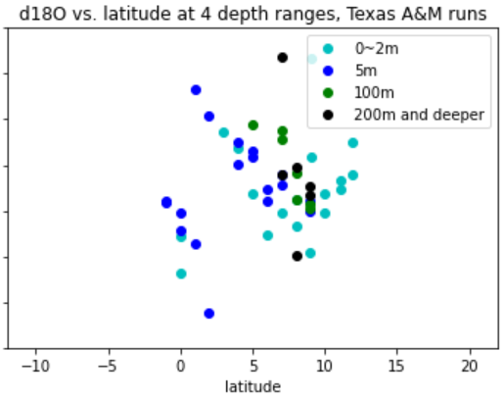
d18O vs. latitude, color-coded by depth, GT and Texas A&M runs
GT
Texas A&M

Slide 3
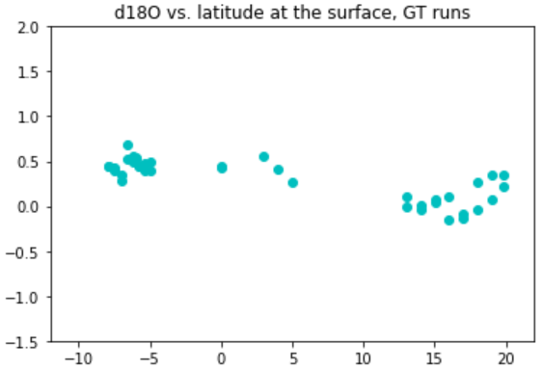
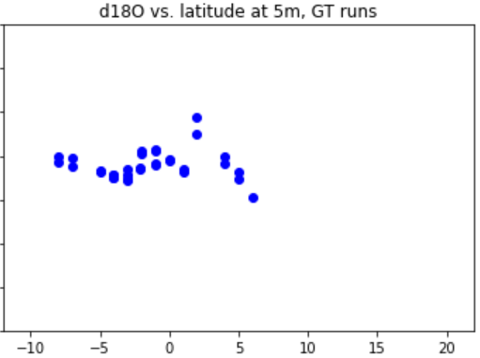
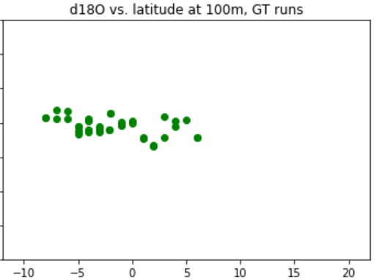
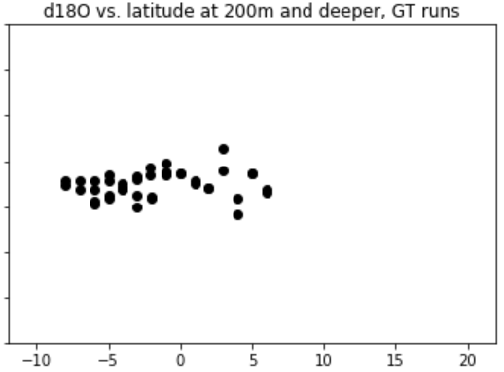
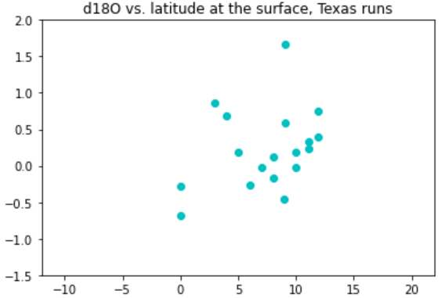
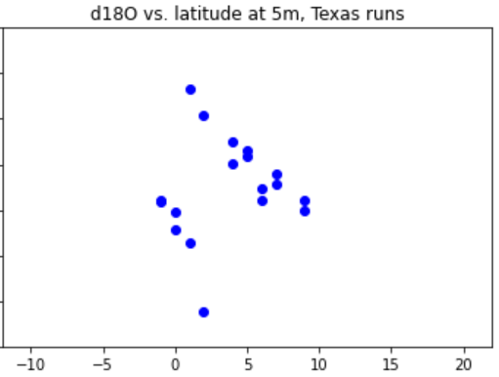
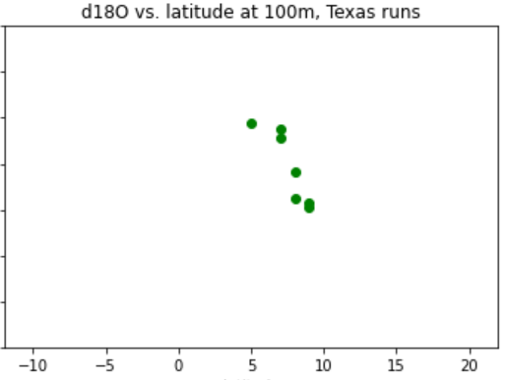
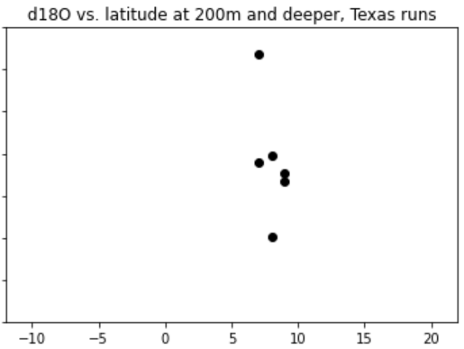
GT
0m
5m
100m
200m and deeper
d18O
Latitude
Texas A&M
0m
5m
100m
200m and deeper
d18O
Latitude

Slide 4
Next Steps
Do 3 sigma rejection test with the Texas A&M data
Do 2 sigma rejection test with Texas A&M data
Plot data spatially (on a map with GIS potentially)
Meet with Chris (email already sent)

